Slide 1
HPID and OEID Overview
Kari Gaare, OESS
April 17, 2013

Slide 2
What is the Purpose of the HPID?
Required to be used in the standard transactions to identify a health plan that has an HPID
Allowed to be used for any other lawful purpose

Slide 3
What does this final rule NOT require?
Does not require that health plans now be identified in the standard transactions if they were not identified before this rule
  For instance, TPA is not now required to identify a self-insured health plan in the standards transactions if the TPA did not identify it prior to this rule

Slide 4
Who is Required to Get the HPID?
Health plans as defined by 45 CFR 160.103
Controlling health plan (CHP) vs. Subhealth plan (SHP)
Entity | Enumeration Requirements | Enumerations Options
CHPs | Must get an HPID for itself | May get an HPID(s) for its SHP(s) May direct its SHP(s) to get HPID(s)
SHPs | Not required to get an HPID | May get an HPID at the direction of its CHP May get an HPID of its own initiative

Slide 5
What is the Timeline for Compliance with the Regulation?
Entity Type | Compliance Date for Obtaining HPID | Full Implementation Date for Using HPID in Standard Transactions
Health Plans, excluding small health plans | November 5, 2014 | November 7, 2016
Small Health Plans* | November 5, 2015 | November 7, 2016
Covered Healthcare Providers | N/A | November 7, 2016
Healthcare Clearinghouses | N/A | November 7, 2016
* Small health plan means a health plan with annual receipts of $5 million or less. (45 CFR 160.103)

Slide 6
What is the Other Entity Identifier
Voluntary Identifier
Must meet following requirements:
  Needs to be identified in the standard transactions
  Is NOT eligible to obtain an NPI
  Is NOT eligible to obtain an HPID
  Is NOT an individual

Slide 7
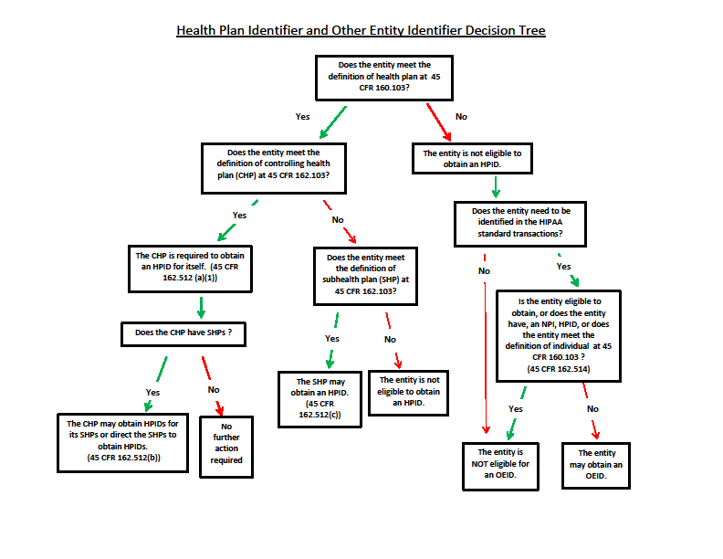
E-Health Steering Committee:
HPID Workgroup
Purpose: Begin planning for CMS enumeration and implementation
OESS role:
  Facilitate an enterprise solution for enumeration and implementation of HPID
  Promote awareness and act as a resource for HPID policy
First Meeting was March 20th

Slide 8
Health Plan and Other Entity Enumeration System (HPOES)
Applications available through HPOES
  Module of Health Insurance Oversight System (HIOS)
Enter through CMS Enterprise Portal
  https://portal.cms.gov/
HPID= begin with 7
OEID= begin with 6

Slide 9
Resources
http://www.cms.gov/Regulations-and-Guidance/HIPAA-Administrative-Simplification/Affordable-Care-Act/Health-Plan-Identifier.html

Slide 10
E-Health Steering Committee:
HPID Workgroup
3 Phases
  Phase I (March – July 2013) – Data and Information Gathering of System and Business processes and policies
    Current use in standard transactions
    Use in other CMS program areas
    Goal = understand current CMS use of identifiers
  Phase II (July 2013 – Jan. 2014) – Analysis and Key Decisions
    Goal = Recommendations on CMS enumeration
  Phase III (Jan. 2014 – Nov. 2016) - Implementation
    Goal = Full implementation by November 7, 2016

Slide 11
QUESTIONS?

